Slide 1
Flood Buyouts Participation
Literature Review

Slide 2
Paper 1
Dineva, P. K., McGranaghan, C., Messer, K. D., Palm-Forster, L. H., Paul, L. A., & Siders, A. R. (2023). Promoting spatial coordination in flood buyouts in the United States: Four strategies and four challenges from the economics of land preservation literature. Natural Hazards Review, 24(1), 04023002. https://doi.org/10.1061/(ASCE)NH.1527-6996.0000485

Slide 3
Purpose
Review 4 strategies from the land preservation/conservation acquisitions literature and how they have potential use for improving buyout participation and reduce fragmentation
Contiguity of acquired homes, purchase cost savings per house, homeowner welfare, homeowner hazard risk reduction
Encourage experimentation of these incentives in a buyout context
Agglomeration bonuses= additional bonus if move in group with neighbors
Reverse auctions= single buyer (gov’t) who obtains offers from multiple sellers (homeowners) and accept lowest offer
Target constraints= impose minimum level of participation for buyout to go through
Hybrids of the 3

Slide 4
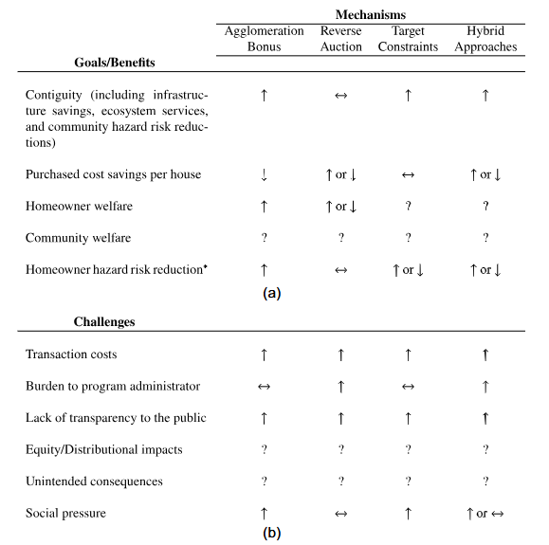
Purpose

Slide 5
Background
Effect participation:
Positively: reduced flood risk, social justice, ecosystem service benefits, community connections, place attachment, mental health, & cultural heritage
Negatively: implementation delays➔ econ burden of participation, complex gov’t systems and high administrative costs, low participation, failure to account for ecological costs/bens in decision making processes, checkerboarding➔ negative effects on local tax base; people don’t agree with assessed FMV, personal value and assessed value are different (subjective values influenced by personal attachment, knowledge of market, financial situation, whether neighbors relocate)
Timing, prices, communities, homeowner perceptions, neighbors’ decisions
Transaction costs, equity and distributional consequences, social pressures

Slide 6
Background
Participation incentives:
NYC (Hurricane Sandy)- (1) additional 10% if relocate from extremely high risk area, (2) additional 5% if relocate w/in NYC, (3) additional 10% if relocate with neighbors
Louisiana (Katrina & Rita)- (1) forfeit 40% of buyout price if relocate outside of Louisiana
New Jersey- (1) $2 million in support for loan forgiveness and short sales for owners that owe more than homes are worth, (2) support funding of attorney and appraiser fees and costs
Harris County, TX- (1) get down payment funds up to 120% of annual median income if relocate outside of 100-year floodplain (after living there at least 2 years), (2) additional lump-sum of $19,779 if relocate outside of 100-year floodplain and remain in Harris County but outside of Houston
North Carolina- (1) can sell land beneath eligible homes and relocate their building and township pays the physical relocation costs

Slide 7
Background
Historically prioritized other strategies: levees, beach nourishment, elevation
2018 US National Climate Assessment says retreat is “unavoidable” under most sea level rise predictions
Voluntary flood buyout program becoming more common→ since 1989 FEMA spent $4 billion to acquire 45,000 homes ; HUD also funds buyouts

Slide 8
Background
Buyout process:
Program typically offered through FEMA or HUD; offer fair market value (FMV) based on pre-disaster or current appraisal
FEMA method- local gov’t makes posted price offers that are “fair, transparent, and equitable,” which is interpreted as the pre-disaster FMV, but could also be the replacement value (price to purchase a nearby home).
Offer accepted or rejected
accept
FEMA
Offer FMV
Homeowner
reject

Slide 9
Agglomeration bonuses
Hypothesis: AB’s increase beneficial spatial coordination b/w neighbors at an additional cost to buyers.
(def) Additional bonus if move in group with neighbors
Cons- can increase cost per home acquired because additional payment, additional program costs
Pros- more spatially efficient, reduced fragmentation and increased contiguity, infrastructure savings, ecosystem service bens, hazard risk reductions, increased homeowner welfare
Combined with cheap talk increases participation
Buyer transparency- info about decisions of direct/indirect neighbors
May depend on size of neighborhood (small/tight-knit)
Concern that AB + cheap talk could lead to social coercion where ppl are pressured to accept buyout to get bonus
Notes:
“In the study, cheap talk was simulated in an economics lab-oratory setting; participants were told that they could communicate with other members of their group between experimental rounds. This finding is significant because direct communication naturally occurs between neighboring homeowners.“

Slide 10
Reverse Auctions
Hypothesis: RA may lower costs, but increase vulnerability to rent seeking or collusion when there are few participants
(def) Single buyer (gov’t) obtains offers from multiple sellers (homeowners) and accept lowest offer
Pros- increased cost-effectiveness and provide greater community welfare,
Concerns- rent-seeking behavior where owners try to profit by offering more than true private value; residents not familiar with this type of mechanism (familiarity can be improved with iterative auction, but this also could increase collusion and increase cost of acquiring homes);
Don’t know- if RA’s increase contiguity, increase/decrease per-home costs, increase/decrease hazard risk

Slide 11
Target Constraints
Hypothesis: TC’s can minimize fragmentation without imposing additional cost on gov’t.
(def) = Impose minimum level of participation for buyout to go through
Pros- envt’l bens (contiguous wetlands, increased flood resilience), only buyouts that go through are the most spatially beneficial
Concerns- social pressure
Success depends on- threshold, mechanism so that homeowners can privately signal their desire to participate to other homeowners,

Slide 12
Hybrid Approaches
Hypothesis: Combining incentives can reduce fragmentation and program costs for the gov’t.
RA + AB- increases acceptance rates but decreases contiguity and thus env’tl bens.
But AB with spatial targeting (allows buyers to place additional value on houses near protected lands) increases both outcomes
RA + Provision Point Mechanism- lowers bids
RA + TC or budget constraint- increased bids only when one-shot (not iterative)

Slide 13
Implementation Challenges
Assessing how buyout tools effect long-term wellbeing of residents
This just focuses on owners, but need to consider renters too!
Transaction costs decrease participation
Buyouts typically implemented in low income communities increasing disparities
Concern if low income res are more likely than high income to sell at loss in RA scenario
How outcomes vary across income levels and how these actors influence where they move
Incentives may have unintended consequences
May relocate to flood prone area, or area with other risks
Disparities in unintended consequences also
If incentivized to remain in area, may have to deal with inflated prices, which also leads to increased segregation
AB and TC may cause social pressure & coercion
May feel coerced because not financially feasible to stay, feared future flooding, disbanding of their neighborhoods, future lack of interest of gov’t in providing services
Owners are more likely to accept buyout offers when they believe their neighbors will also accept
Residents accept buyouts can create future financial burdens on residents don’t through additional taxes to maintain community services or a loss of services because of smaller tax bases.
Residents reject buyout can deprive their neighbors of AB’s, reduce the effectiveness of the program by checkerboarding, and even force cancellation of the program.
Future research: what level of AB can encourage coordination w/o applying social pressure
Notes:
“Ando and Reeser(2022) found that homeowners had a positive willingness to pay for bundling buyout and insurance to reduce the time between a natural disaster and either an insurance payout or buyout.”
“Numerous studies have found that low-income communities frequently are at greater risk of flooding than high-income communities, have few protective measures in place, and find it more difficult to recover after a disaster”
“A good approach to inves-tigating such effects would be to conduct economic and behavioralexperiments to assess whether and how much reverse auctions de-crease purchase prices and how owners’ incomes and past experi-ences with flooding affect their willingness to sell at a loss. “
“For example, McGhee et al. (2020) studied323 New York households that relocated following HurricaneSandy and found that 20% of the households relocated to areas thatwere at risk of flooding and 95% moved to neighborhoods withhigher poverty rates, which has been shown to reduce the future earning potential of children (Chetty and Hendren 2018). Similarly,Loughran and Elliott (2019) conducted a study of 1,782 HarrisCounty, Texas, buyouts between January 2000 and August 2017;they found that roughly 9 out of 10 homeowners relocated withinthe metropolitan area, and that Hispanic and Black homeownerswere significantly more likely to relocate locally (within the metroarea) compared to White homeowners. “

Slide 14
Paper 2
Paul, L. A., McGranaghan, C., Siders, A. R., Dineva, P. K., Palm-Forster, L. H., & Messer, K. D. (2024). Addressing coordination problems in residential buyouts: Experimental evidence for managed retreat in the face of climate change-related threats. Journal of Economic Behavior and Organization, 226, 106670. https://doi.org/10.1016/j.jebo.2024.106670

Slide 15
Purpose
Buyouts pose a moral hazard problem because owners’ subjective value and unobservable attachment to home.
Research question: Do additional incentives decrease checkerboarding?
Coordination Problem
Attachment to place or community
Coordination failure if stay or leave
Spatial dependence of benefits
Decision to accept or reject affects valuations of other properties and the public benefits to the community

Slide 16
Background
FEMA & HUD provide funding to local & state gov’t, who make posted price (take-it-or-leave-it) buyout offers to owners and oversee process
Typically use pre/post-flood FMV
Owners accept or reject or dispute value by hiring a second appraiser

Slide 17
Background
Complete/efficient buyout = when the whole neighborhood is relocated. This paper assumes wetland values and infrastructure savings increase under this scenario.
Assume homogeneous place & community attachment values, but think heterogenous in reality, and RA allow for heterogeneity without measurement of unobservable values
Perceptions of fairness and voluntariness
Subjective valuation depends on emotional attachment to place, neighborhood, and neighbors
Checkerboarding may raise local taxes for those who remain
More adjoined land has better env’tl outcomes (wetlands, habitats) and make it more cost effective to remove infrastructure for open space

Slide 18
Background
Social dilemmas
Individual decisions are interconnected
Incentives motivate individual behavior that leads to sub-optimal group outcomes
Coordination problems
Individ bens are effected by decisions of others which are not known ex ante
Reluctance to reveal values to neighbors
edfvjkm

Slide 19
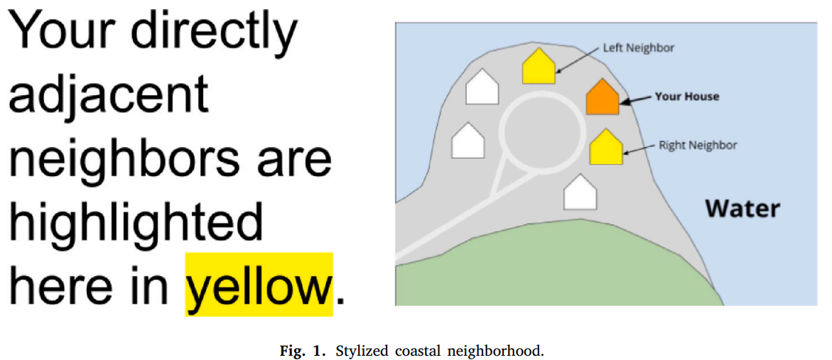
Experiment
372 undergrads in person
Stylized coastal neighborhoods with circular (reduces asymmetries) networks of 6 homes and homogeneous home values and community attachment levels
Implement 2 buyout mechanisms: posted price (PP) and reverse auction (RA) b/w subjects & 4 combos of program features (control with neither, agglomeration bonuses (AB), target constraint (TC), AB + TC)
In each period neighborhoods have a fixed probability of experiencing a flood that costs = damages per home
Each home has market value of $100, each homeowner values their home $20 above FMV and values their adjacent neighbors $5 each, 0 community attachment to other neighbors. This totals $130 subjective value if no flood.
25% chance of flooding each period. If flood, all homes value decreases 50%
Collect info to calculate risk aversion
Period 1: Default
Under PP the dominant option in expected value is to reject offer
Under RA
Period 2: AB only
Accepting is dominant
Period 3: TC only (3 houses min)
Rejecting is dominant
Period 4: AB + TC
Accepting is always dominant

Slide 20
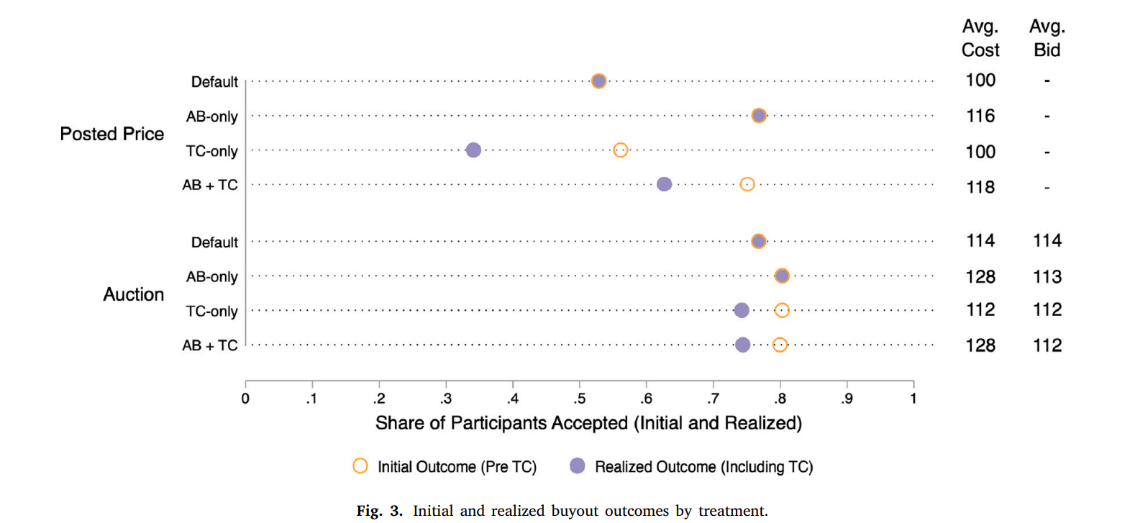
Findings
RA increase coordination (increased buyout rates and contiguity)
Acceptance rates are lower with PP at FMV (w/ place and community attachment & heterogeneity in risk aversion)
More ppl prefer accepting offer and leaving
Default PP had 53% acceptance
PP + AB had 77% acceptance
PP + TC had 34% acceptance
PP + AB + TC had 75% acceptance
Default RA had 77% acceptance
RA + AB had 80% acceptance
RA + TC had 74% acceptance
RA + AB + TC had 74% acceptance

Slide 21
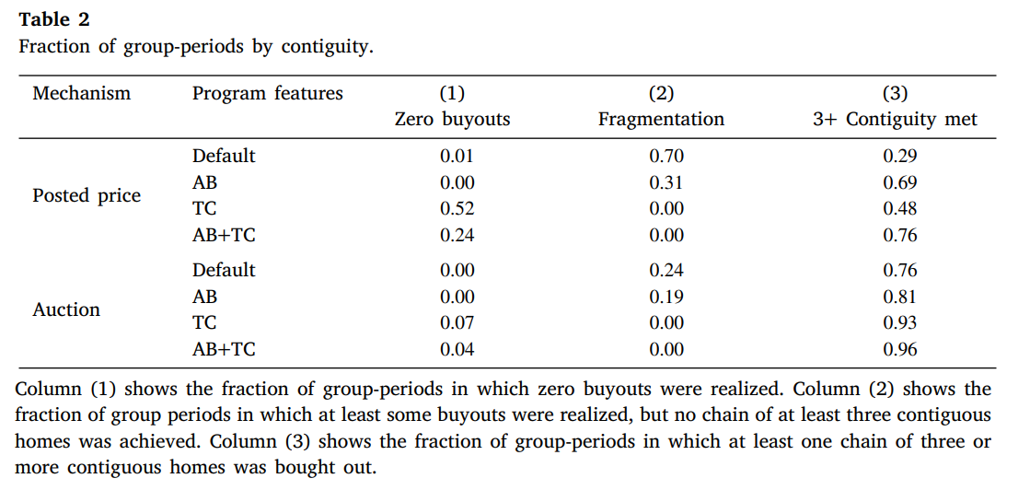
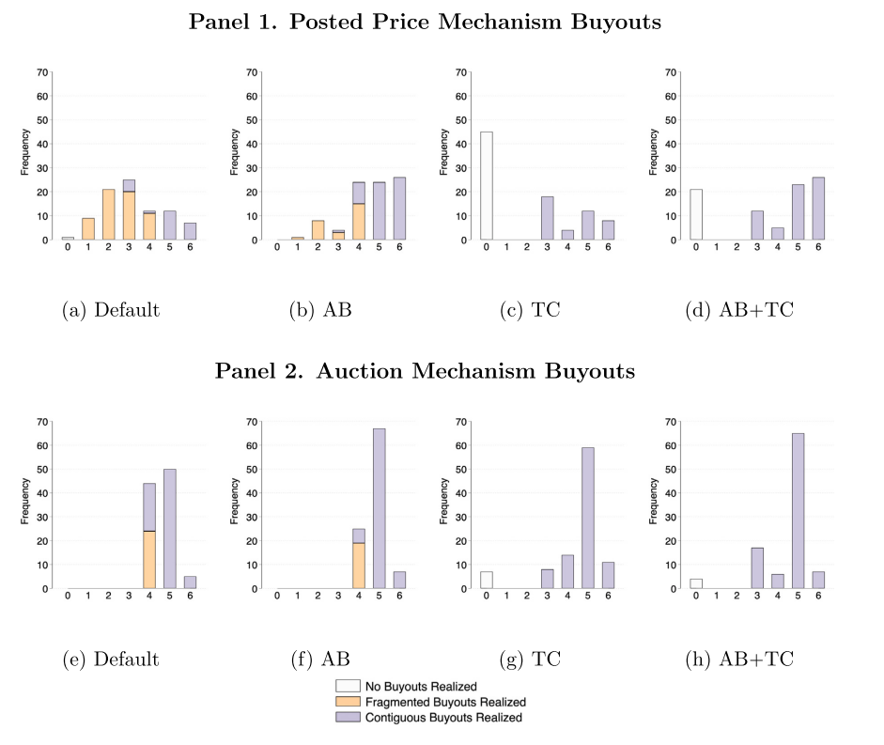
Findings
PP/RA TC and AB + TC➔ lower fragmentation
Overall: both RA and AB improve coordination; RA also accommodate heterogeneity; these may be perceived as less coercive

Slide 22
Individual participation choices
Regressions to see what incentivizes decisions
PP
Regression: reg acceptance dummy on dummies for AB/TC/AB+TC, period fixed fx to account for learning, participant fixed fx, past buyout outcomes, variable for how many periods have gone since flood was realized, indicator for number of neighbors who accepted in previous period
Results: AB and AB+TC increase acceptance, increased participation if 2 neighbors participate
RA
Regression: reg bid on dummies for AB/TC/AB+TC, individual fixed fx, variable for how many periods have gone since flood was realized, variable for bid of neighbors previous period
Results: AB lowers bids by $2.43 (because it could be risky if bid too high), prior bid indicator increases bids by $2.84 (suggests rent seeking behavior),

Slide 23
Quantify env’tl and public benefits
Wetlands
PP + AB best or RA best depending on scenario

